Slide 1
Analyzing play calling in the national football league
Priyam Patel
INFO 550

Slide 2
Motivations
Sports analytics have been on the rise, particularly in sports like baseball and basketball, where metrics are easier to come by
NFL has become a late adopter
2019 Baltimore Ravens, AFC #1 seed
During games, Coach John Harbaugh is advised by football analyst on play calling percentages
Major shift in NFL play calling in recent years
2018 Super Bowl LII, Eagles won 41-33, trick play
Slew of trick play calling has followed, coaches incorporating college play calling
2019 Steelers, top three quarterbacks injured, fell back on “wildcat”
Intentional penalties in the 2019 playoffs
More “dual-threat” QBs, more passing plays
But what do the numbers say about this shift? Is the new paradigm for play calling effective?

Slide 3



Data sources (Rejected)
Pro Football Reference
Box score data, player data, game play-by-play, season data
Individual tables of data exportable as csv files
Limited to 500 plays at a time, requires tedious manual filtering to compile data for a season
Twitter
rtweets package – very useful for streaming tweets or searching for recent tweets on topics, but no date filter

Slide 4
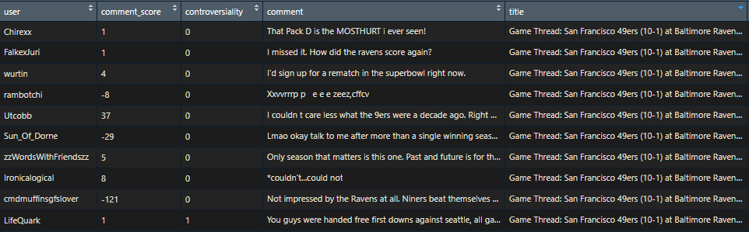
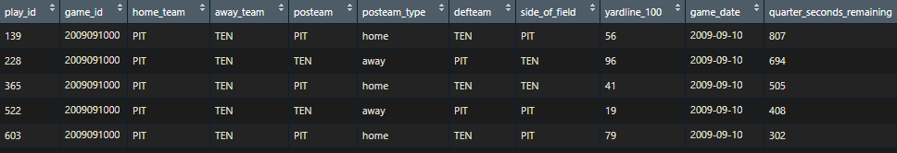
Data sources (accepted)
NFL.com API
nflscrapR – contains functions to pull, parse, and clean data from the publicly-available NFL.com API
Includes player statistics, box scores, game play-by-play, and season play-by-play
256 features
Reddit
reddit.com/r/nfl – contains “Game Threads” for each of the 256 regular season games and 11 playoff games
18 features

Slide 5
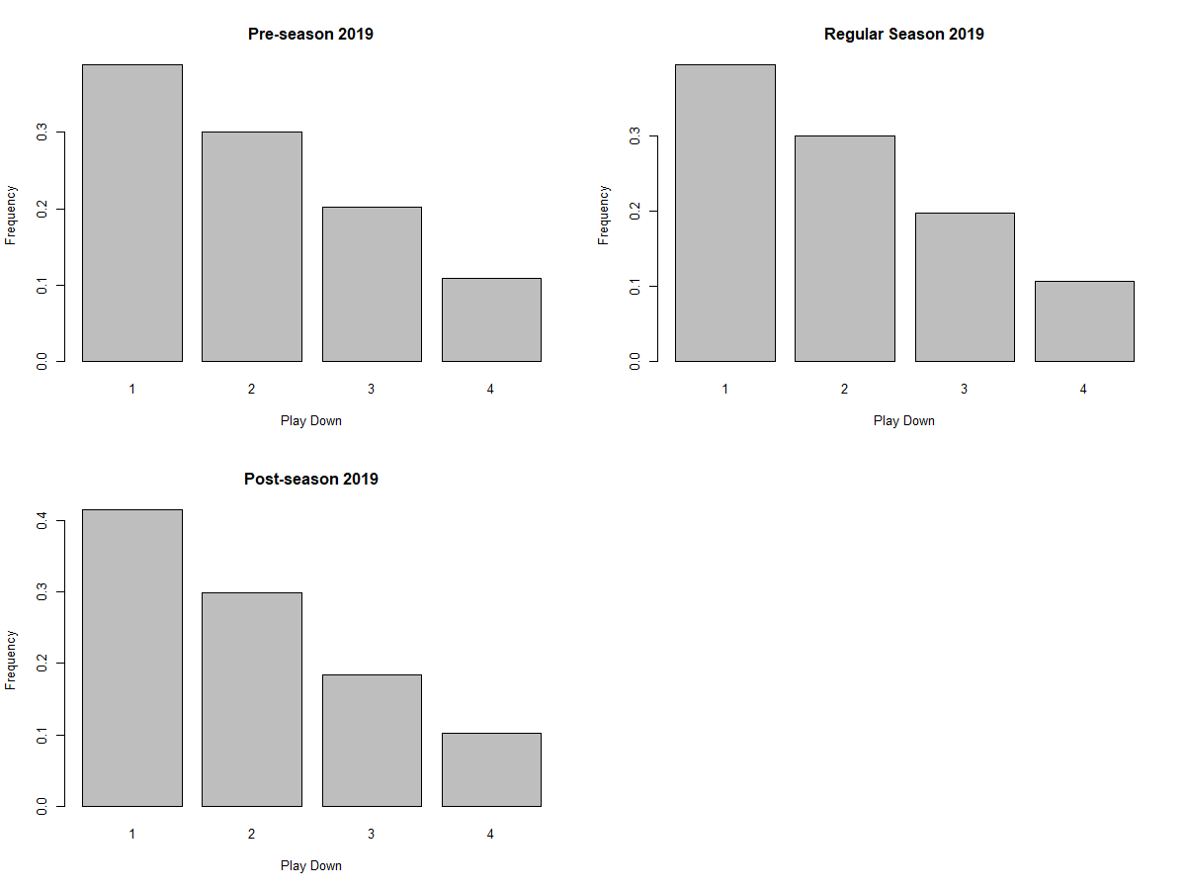
data exploration
Experimented with data storage options
csv versus rds for performance
Best option for dynamic application?
Explored 2019 season play-by-play data with dplyr
Created basic visualizations to better understand data
Scraped Reddit NFL game threads to get a sense of API limitations

Slide 6
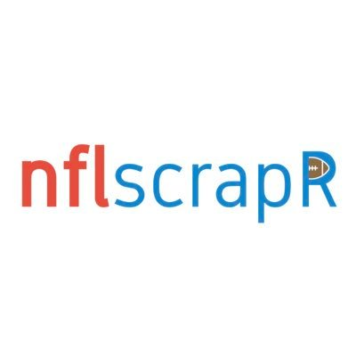

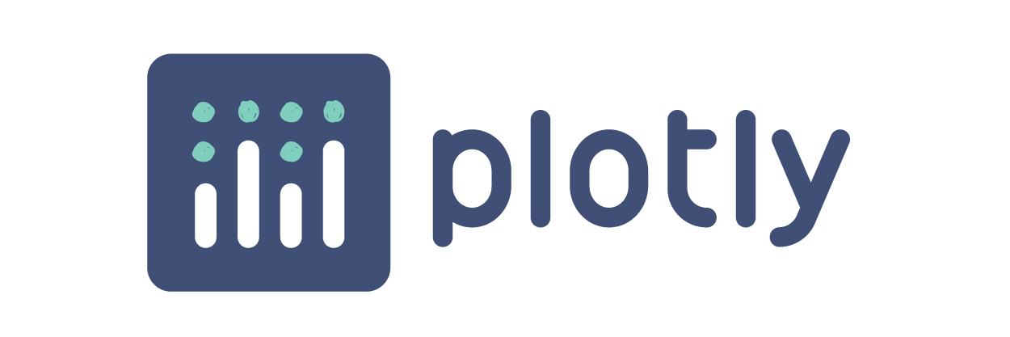
R packages
tidyverse
ggplot2, dplyr, tidyr, readr, stringr
shiny
plotly
nflscrapR
RedditExtractoR
tidytext

Slide 7
Research questions
How does play calling per down change from preseason to postseason? Over the years and by team?
In the post-season, what is the most effective playcall for each down and distance (non-redzone plays)?
How did public sentiment about a team change after risky playcalls in the 2019-20 season?

Slide 8
Anticipated direction
Develop a Shiny web application (or Shiny document) to answer the research questions with dynamic visualizations and analysis
How does play calling per down change from preseason to postseason? Over the years and by team?
Develop reactive plot from NFL data
In the post-season, what is the most effective playcall for each down and distance (non-redzone plays)?
Create model using NFL data that incorporates playcall, down, distance, and potentially other variables
How did public sentiment about a team change after risky playcalls in the 2019-20 season?
Use NFL data to identify games with “risky playcalls,” conduct sentiment analysis of related Reddit Game Threads

Slide 9
Questions?

